Slide 1


Department of Computer Science and Engineering
PREDICTIVE POWER MACHINE LEARNING MODELS FOR MACHINE FAILURE STATUS
ABINAYA S [211421104005]
ABINISHEKA S S [211421104006]
DARSHINI A[211421104048]
PROJECT COORDINATOR:
DR.S.KAVITHA SUBRAMANI.,M.E.,PH.D.,
SUPERVISOR,PROFESSOR
GUIDE:
MRS.S.SOPHANA JENNIFER.,M.E
ASSISTANT PROFESSOR

Slide 2
ABSTRACT
In Industries, predicting machine failures in advance is crucial to reducing downtime and improving efficiency.
This project focuses on building machine learning models to predict when industrial machines might fail.
The process includes cleaning and preparing the data to ensure accuracy, visualizing the data to identify useful patterns, and implementing suitable machine learning models.
The final predictive models are integrated with a Django-based web interface, making it easy for users to monitor machine conditions and get failure predictions.
This system helps in making timely maintenance decisions, improving reliability and efficiency.

Slide 3
INTRODUCTION
Traditional maintenance methods rely on scheduled inspections or reactive repairs after a failure occurs, which can be costly and inefficient.
This project introduces a predictive maintenance system that leverages machine learning to anticipate machine failures before they happen. By analyzing data from industrial machines, our system identifies patterns and predicts potential breakdowns. The workflow includes data preprocessing to clean and prepare data, visualization to uncover useful insights, and model implementation to generate accurate failure predictions.
To make this technology accessible, we have integrated the predictive models into a Django-based web application, allowing users to monitor machine health and receive alerts for proactive maintenance. This approach not only reduces downtime and repair costs but also enhances overall operational efficiency.

Slide 4
OBJECTIVES OF THE PROJECT
PATTERN IDENTIFICATION
PREDICTS TYPE OF MACHINE FAILURE
BETTER ACCURACY
ENHANCE MAINTENANCE
IMPROVING INDUSTRIAL PRODUCTIVITY

Slide 5
LITERATURE SURVEY
TITLE | AUTHOR | YEAR | METHODOLOGY
Machine Failure Prediction Using Machine Learning | Varshini Manda, Dr. K. Neeraja | 2021 | This paper follows a step-by-step approach to study how machine learning (ML) techniques are used for predicting machine failures in industries. The paper also examines how ML is applied in different industries like hardware and software and evaluates which techniques are most effective. Through this analysis, LSTM (Long Short-Term Memory) is found to be one of the most commonly used and effective methods for predicting machine failures.

Slide 6
LITERATURE SURVEY
TITLE | AUTHOR | YEAR | METHODOLOGY
Predictive Maintenance using machine learning on water pump | Dr. Sharda Chhabria, Rahul Ghata, Varun Mehta, Ayushi Ghosekar, Manasi Araspur, Nandita Pakhide | 2022 | This study focuses on predicting water pump failures using machine learning (ML) and IoT (Internet of Things) technologies. The process begins with collecting real-time data from water pumps. This data is then processed and analyzed. Next,a ML model using the Random Forest algorithm is implemented. The system is also integrated with IoT devices, which allow for real-time monitoring.This approach enables industries to take preventive actions before a pump breaks down

Slide 7
LITERATURE SURVEY
TITLE | AUTHOR | YEAR | METHODOLOGY
Using Machine Learning and Deep Learning Algorithms for Downtime Minimization in the Manufacturing Systems: An Early Failure Detection Diagnostic Service | Mohammad Shahin | 2023 | This study explores how machine learning (ML), deep learning (DL), and deep hybrid learning (DHL) can help detect failures early and reduce downtime in manufacturing systems.The study tests over 20 different fault detection models. The performance of these models is then evaluated using accuracy, precision, recall, and F-score to determine which ones work best. The results show that Deep Forest and Gradient Boosting algorithms performed the best, with over 90% accuracy.

Slide 8
LITERATURE SURVEY
TITLE | AUTHOR | YEAR | METHODOLOGY
Machine Predictive Maintenance Using machine Learning | Logith Vikram K1 , Lohit T2 , Duvarakesh R | 2024 | This project uses machine learning (ML) to predict machine failures. A ML model is developed to predict when a machine might need maintenance. The system continuously monitors machine conditions in real time and provides alerts before a failure occurs.The project also compares reactive maintenance (fixing machines after failure), preventive maintenance (regular check-ups), and predictive maintenance (using ML to prevent failures).By integrating ML, this system helps industries lower maintenance costs .

Slide 9
EXISTING SYSTEM
In many industries, AI models are used for making important decisions, like predicting machine failures or detecting issues in critical systems. However, these models sometimes make mistakes but still act very confident in their wrong predictions.
There are two main types of incorrect predictions:
Misclassified Samples – The model predicts incorrectly but still gives a high confidence score.
Example: A machine that is actually failing is predicted as "Normal" with high confidence.
Out-of-Distribution (OOD) Samples – The model sees completely new data (never seen before) and misclassifies it with high confidence.
Example: A model trained on one type of machine tries to predict failures for a different type of machine and fails.

Slide 10
EXISTING SYSTEM
Solution: Flat Minima
To fix this, researchers introduced a new method called Flat Minima, which helps the model clearly separate correct predictions from incorrect ones. This method improves failure prediction across different conditions:
-> balanced [Known data]
-> long-tailed [Limited data]
-> covariate-shift classification scenarios [Pattern change]
Focus on:
--Wrong predictions
--No practical implementation
--Improving the model accuracy

Slide 11
PROPOSED SYSTEM
1.PREDICTS TYPE OF FAILURE
🔹The system not only detects whether a failure will occur but also identifies the type of failure (e.g., mechanical, electrical, or operational).
🔹 Helps industries take specific preventive actions based on the failure type.
2.PROVIDES PREVENTIVE MEASURES AND MAINTENANCE
🔹 Instead of reacting after a failure, the system suggests preventive actions to avoid breakdowns.
🔹 Helps in scheduling maintenance at the right time, reducing repair costs and downtime.

Slide 12
PROPOSED SYSTEM
3.HIGH ACCURACY ALGORITHM
🔹 Uses advanced machine learning models to ensure accurate predictions.
🔹Improves over existing methods by handling imbalanced, changing, and complex data more
4.USER-FRIENDLY INTERFACE
🔹 A Django-based web application makes the system easy to use for engineers and operators.
🔹 Provides real-time failure predictions, visual insights, and interactive monitoring, improving practical usability compared to traditional models.

Slide 13
TYPES OF FAILURE
_{HEAT DISSIPATION FAILURE}
_{OVERSTRAIN FAILURE}
_{RANDOM FAILURE}
_{POWER FAILURE}
_{TOOL WEAR FAILURE}

Slide 14
SOFTWARE/ HARDWARE USED
SOFTWARE REQUIREMENTS:
Operating System: Windows 10 or later
Visual Studio Code – Used for writing and running the code efficiently
Anaconda with Jupyter Notebook–data preprocessing and model development
Django Framework –backend development and web application integration
Libraries: NumPy, Pandas, Scikit-Learn, Matplotlib etc.
HARDWARE REQUIREMENTS:
Processor: Intel i3 or higher
Hard Disk: Minimum 80 GB
RAM: At least 2 GB

Slide 15
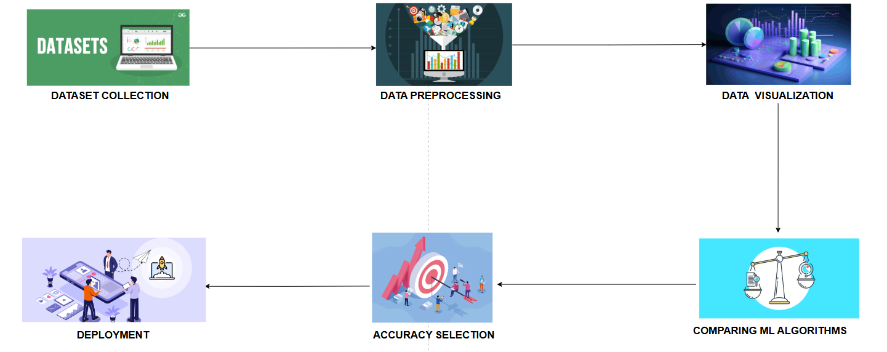
SYSTEM ARCHITECTURE

Slide 16
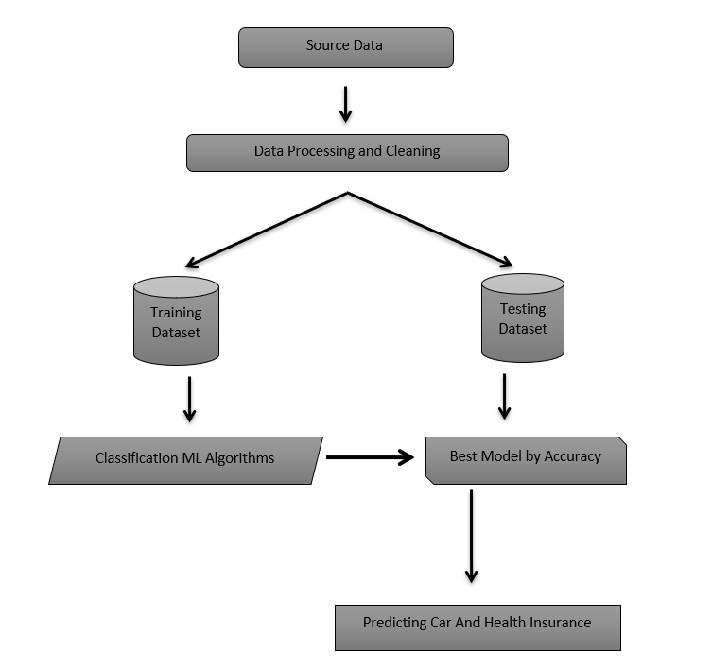
SYSTEM DESIGN
1.WORKFLOW

Slide 17
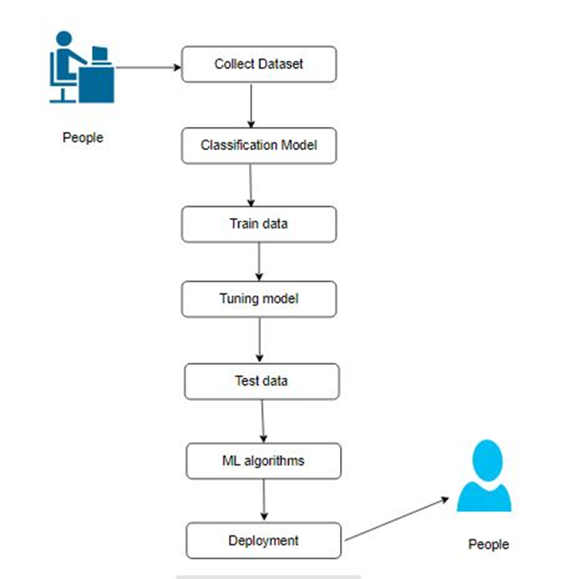
SYSTEM DESIGN
2.USECASE DIAGRAM

Slide 18
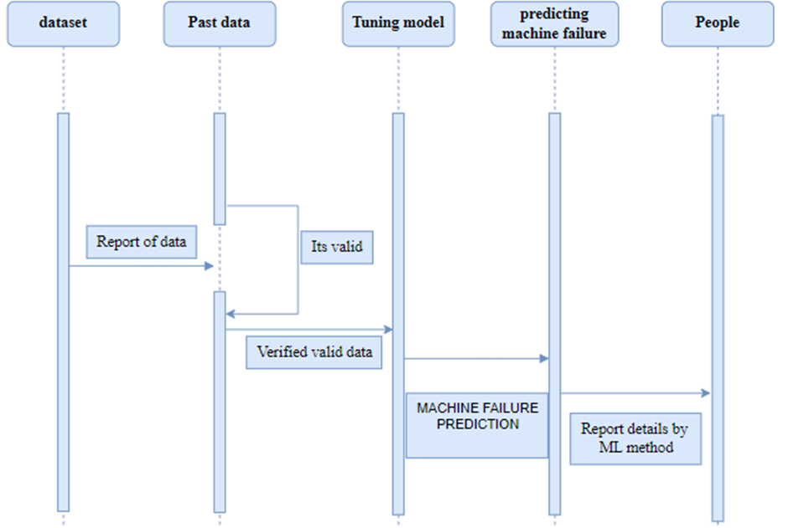
SYSTEM DESIGN
3.SEQUENCE DIAGRAM

Slide 19
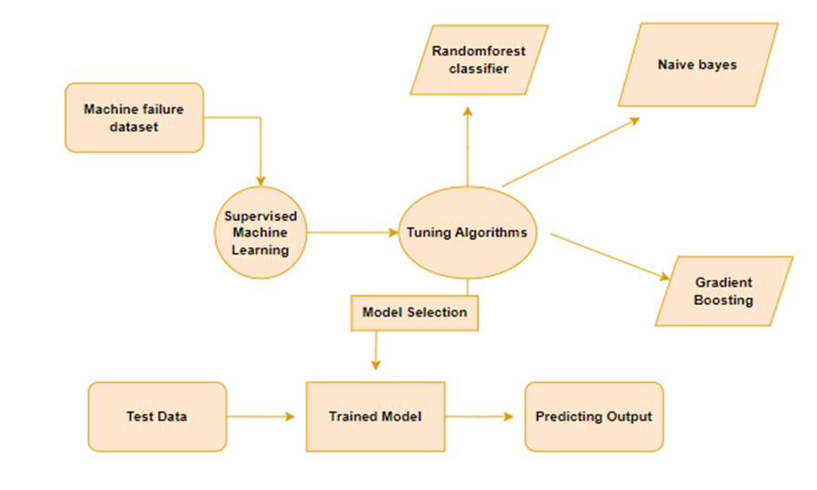
SYSTEM DESIGN
4.ER DIAGRAM

Slide 20
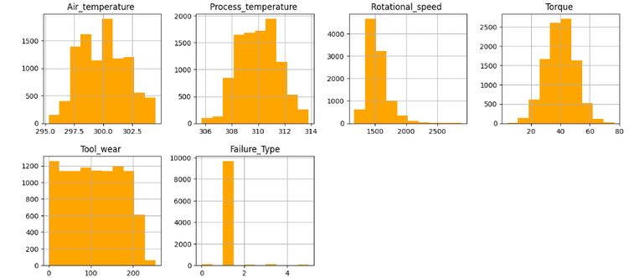
MODULE DESCRIPTION
1.DATA PREPROCESSING MODULE
Cleans and normalizes raw machine data.
Handles missing values and outliers for accurate predictions.
2.DATA VISUALIZATION MODULE
Uses graphs and charts to analyze machine performance trends.
Selects the most critical features affecting machine failure.

Slide 21

MODULE DESCRIPTION
3.MACHINE LEARNING MODEL MODULE
Implements algorithms like Random Forest, Gradient Boosting, etc.
Trains the model to predict different types of machine failures.
4.USER INTERFACE &WEB INTEGRATION MODULE
Built using Django Framework and Visual Studio Code for deployment.
Provides a web-based platform for users to input machine data and get failure predictions

Slide 22
ALGORITHM DESCRIPTION
1. RANDOM FOREST CLASSIFIER
2. NAIVE BAYES CLASSIFIER
Works by creating multiple decision trees and combining their results to make a final prediction.
ACCURACY- 99.93%
Assumes that each feature works independently, which may not always be true.
ACCURACY-39.19%
3.GRADIENT BOOSTING ALGORITHM
Learns step by step, correcting its mistakes in each round.
ACCURACY-98.85%

Slide 23
RESULTS
The results of our predictive power machine learning model for machine failure status indicate that the Random Forest Classifier achieved the highest accuracy of 99.93%, making it the most reliable algorithm for failure prediction.
Naive Bayes Classifier performed poorly with an accuracy of only 39.19%, due to its assumption that all input features are independent, which is not ideal for machine failure prediction.
These findings highlight that Random Forest Classifier and Gradient Boosting Algorithm are the most suitable algorithms for predictive maintenance, providing a highly accurate and reliable approach to detecting failures in advance.
The low performance of Naive Bayes Classifier confirms that simpler probabilistic models are not effective for this type of complex problem.

Slide 24
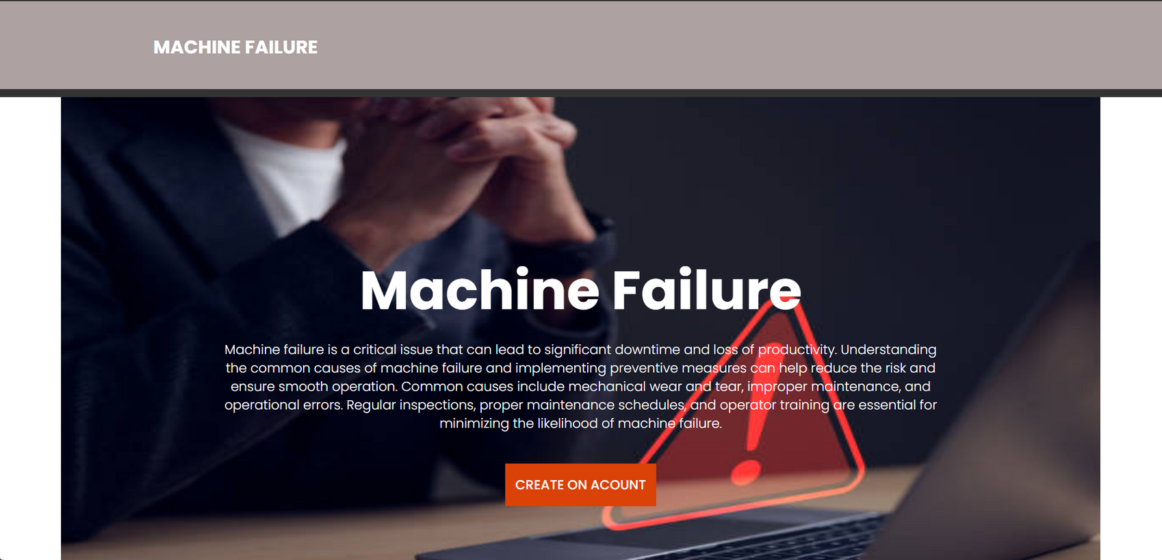
SCREENSHOTS
1.ACCOUNT CREATION PAGE

Slide 25
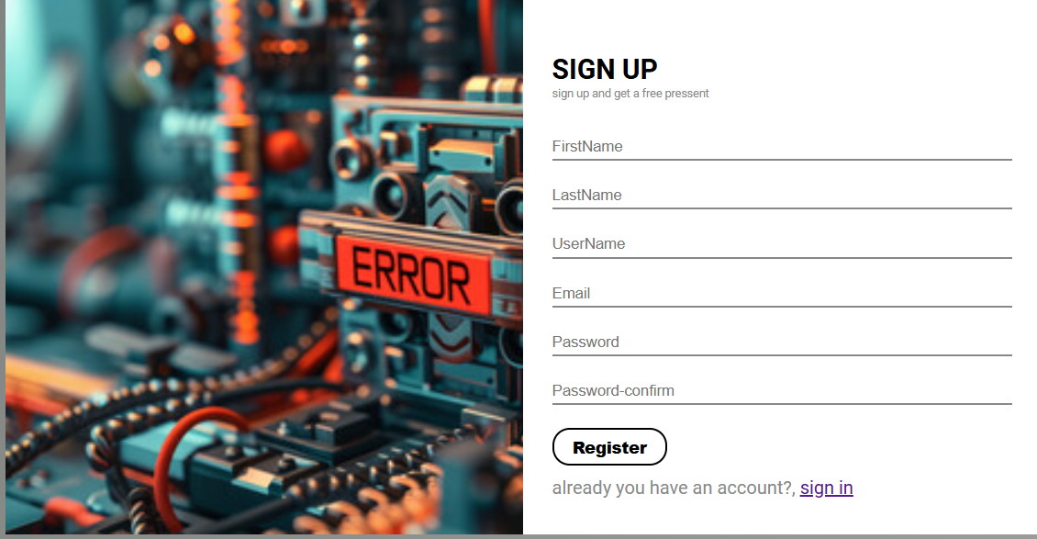
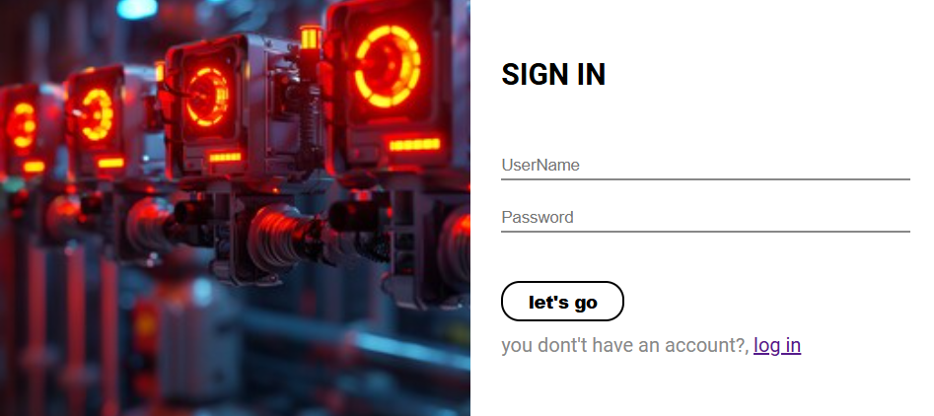
SCREENSHOTS
2.SIGNUP PAGE
3.SIGNIN PAGE

Slide 26
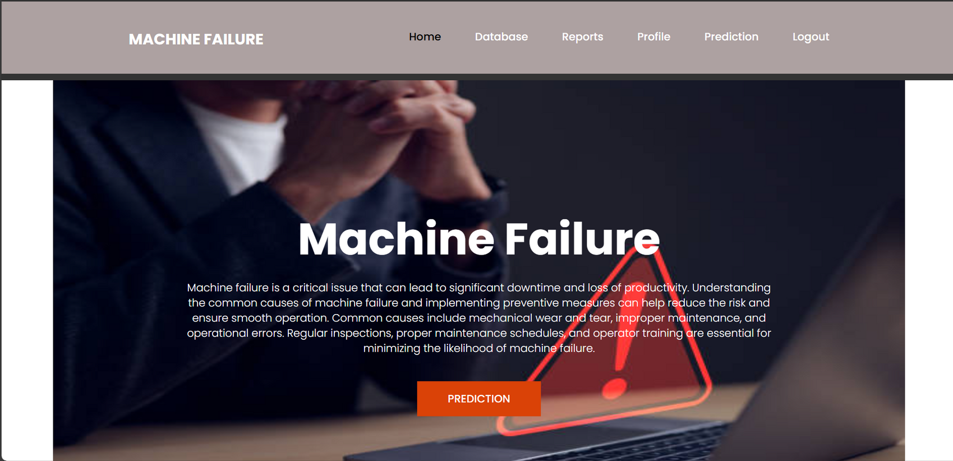
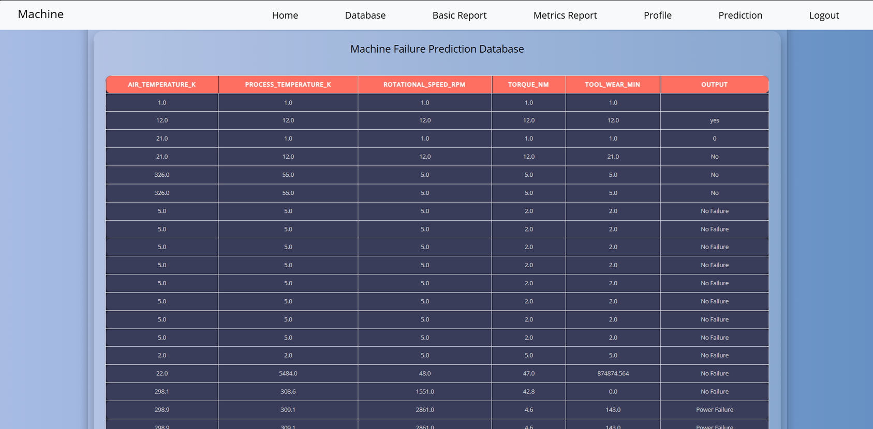
SCREENSHOTS
4.HOME PAGE
5.DATABASE PAGE

Slide 27
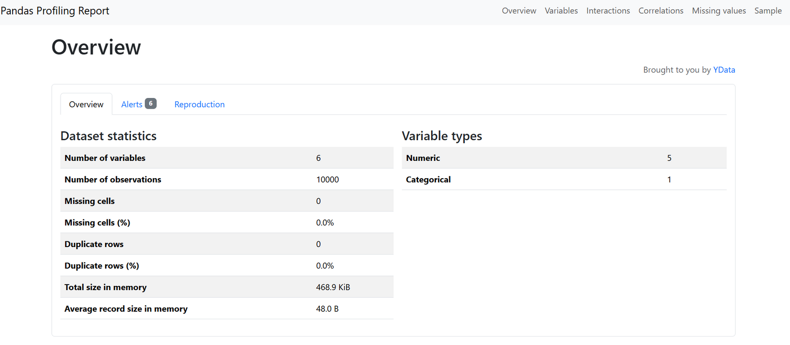
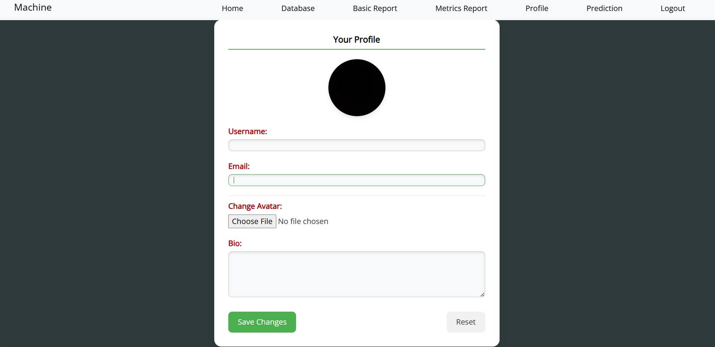
SCREENSHOTS
6.REPORT PAGE
7.PROFILE PAGE

Slide 28
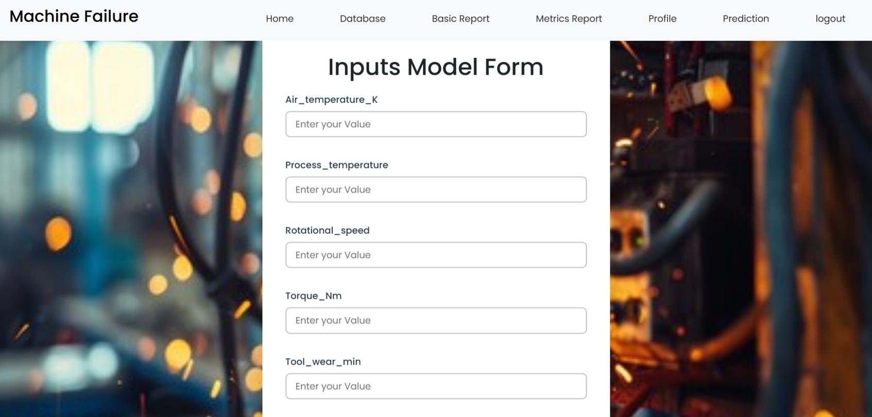
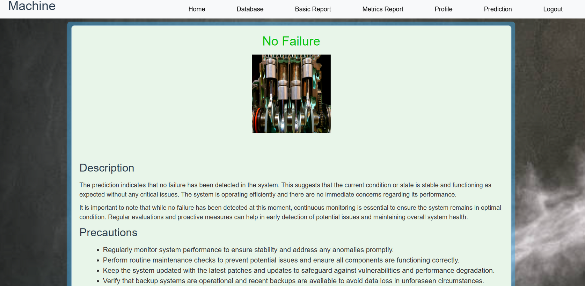
SCREENSHOTS
8.PREDICTION PAGE
9.RESULT PAGE

Slide 29
FUTURE ENHANCEMENT
Future enhancements include integrating real-time data using IoT sensors for instant failure detection and proactive maintenance.
The model can be customized for different industries, ensuring more precise predictions.
A cloud-based implementation would allow remote access and seamless data updates. Additionally, an AI-driven recommendation system could automate maintenance schedules.
Implementing self-learning mechanisms will help the model adapt over time, improving accuracy.
Finally, a mobile-friendly interface can enable users to monitor machine status and receive alerts on the go, making predictive maintenance more efficient and scalable.

Slide 30
REFERENCES
[1] Machine Failure Prediction Using Machine
Learning,Varshini Manda, Dr. K. Neeraja[2021]
[2]Predictive Maintenance using machine learning on water pump,Dr. Sharda Chhabria, Rahul Ghata, Varun Mehta, Ayushi Ghosekar, Manasi Araspur, Nandita Pakhide [2022]
[3]Using Machine Learning and Deep Learning Algorithms for Downtime Minimization in the Manufacturing Systems,
An Early Failure Detection Diagnostic Service,Mohammad Shahin [2023]
[4]Machine Predictive Maintenance Using machine Learning,Logith Vikram K1 , Lohit T2 , Duvarakesh R [2024]
[5]Revisiting Confidence Estimation:Towards Reliable Failure Prediction, Fei Zhu, Xu-Yao Zhang, Zhen Cheng,Cheng-Lin Liu [2024]

